Slide 1
The Methodist Church of
Southern Africa
EMMU Probationer January Seminar
20 January 2026

Slide 2
RANNOI SEDUMO
MCSA GENERAL TREASURER

Slide 3
Topics
Understanding Financial Wellness.
7 Reasons why money management is important.
How to budget.
John Wesley’s money principles.
God’s way of managing money.

Slide 4
Personal Financial Wellness
Wellness is a state.
If it is a state, then it must be measurable in some way.
If it is measurable, the state of wellness for different people will differ based on certain conditions.

Slide 5
What is Financial Wellbeing?
Financial wellbeing is different to financial wealth. While wealth might be about bank balances and net worth, wellbeing is about how the way you manage money affects your life overall.
It’s about being able to meet your financial obligations, be financially prepared for an unexpected event, able to save for future goals including retirement and having the financial freedom to make choices that allow you to enjoy life – now, in the future and under adverse circumstances.
Put simply, financial wellbeing is:
Meeting your every day finances and managing income, expenses and debt responsibly
Being prepared for a rainy day and being able to bounce back
Managing your one day finances to achieve medium and long-term goals

Slide 6
Personal Financial Wellness
When we aren’t on top of our finances, it can feel as if our money is making choices for us. Our financial wellbeing can suffer and our dreams for the future can feel unachievable when we are unable to regularly work towards them.

Slide 7

7 Reasons why money management is important
What exactly is money management?
Money management is the skill of handling your finances effectively. It involves understanding your income sources, making smart spending decisions, setting aside funds for the future, and finding ways to grow your wealth.
Good money management helps you meet your current needs while preparing for what’s ahead. It’s about planning, developing strong saving habits, and being thoughtful with your spending to achieve your financial goals.

Slide 8
7 Reasons why money management is important
1. Financial Freedom
  Financial freedom means comfortable living and having a sustainable amount without relying on a pay day. It’s the ability to say “no” to unfulfilling work or “yes” to passion projects without fear of economic repercussions.
  This freedom isn’t reserved for the ultra-wealthy; it’s achievable through smart money management practices. You’re not just surviving pay day to pay day — you’re building a future where money works for you, not against you.
2. Stress Reduction
  Financial stress often stems from uncertainty and lack of control. Questions about paying rent or affording unexpected repairs can plague your thoughts, leading to sleepless nights and strained relationships.
  However, solid money management practices buffer against these worries, reducing anxiety and allowing you to focus on what truly matters in life.
3. Goal Achievement
  Whether it’s buying a home, starting a business, or travelling the world, proper money management turns dreams into achievable goals.
  Instead of viewing these aspirations as impossible, good financial practices help you calculate necessary savings, improve your credit score, and plan for major expenses. It provides a roadmap, helping you allocate resources efficiently towards your aspirations.

Slide 9
7 Reasons why money management is important
4. Emergency Preparedness
Life is unpredictable. A well-managed emergency fund acts as a financial airbag, cushioning the blow of sudden job loss, medical emergencies, or unforeseen repairs.
Financial readiness allows you to navigate these challenges rather than merely survive them.
5. Improved Relationships
Money disputes are a leading cause of relationship strain. Couples who manage money well report higher relationship satisfaction. By managing finances wisely, you’re not just balancing books — you’re fostering trust and reducing conflicts in your personal life.
6. Wealth Building
Wealth building through money management isn’t about getting rich quickly. It’s about making consistent, informed decisions that compound over time. The impact extends beyond personal finance. It allows you to take calculated risks, like starting a business or changing careers.
It also enables you to capitalize on investment opportunities, turning income into long-term wealth.

Slide 10
7 Reasons why money management is important
7. Legacy Creation
Legacy creation extends the impact of your financial decisions far beyond your lifetime. It’s about nurturing an economic ecosystem that continues to bear fruit long after you’re gone.
A well-structured financial plan can ensure that the wealth you’ve built continues to provide value for years to come. It can provide a fertile ground for your descendants to grow and thrive.
Bottom line.
Effective money management is not just about accumulating wealth — it’s about creating a stable, stress-free financial future that allows you to live life on your terms.
With proper financial planning , you’re not only securing your future but potentially changing the financial trajectory of generations to come.

Slide 11
HOW TO BUDGET?

Slide 12
The 50/30/20 Rule Budgeting
The 50/30/20 rule divides your after-tax income into three categories: 50% for needs, 30% for wants, and 20% for savings or debt repayment.
This budgeting method is easy to understand, encourages balanced spending, and helps foster financial discipline and awareness.
To adopt the 50/30/20 rule, track your income, categorize expenses, and adjust for variable income when necessary.
The rule may not suit everyone. Alternatives such as the zero-based budget or 80/20 method could be a better fit, depending on your financial situation.
In a world where financial decisions may sometimes feel overwhelming, the 50/30/20 rule provides a budgeting method that encourages responsible spending while allowing you to save.
Whether you're aiming to save for a major purchase, pay off debt, or simply take control of your finances, this budgeting system offers a balanced approach to ensure that both your financial needs and desires are met.

Slide 13

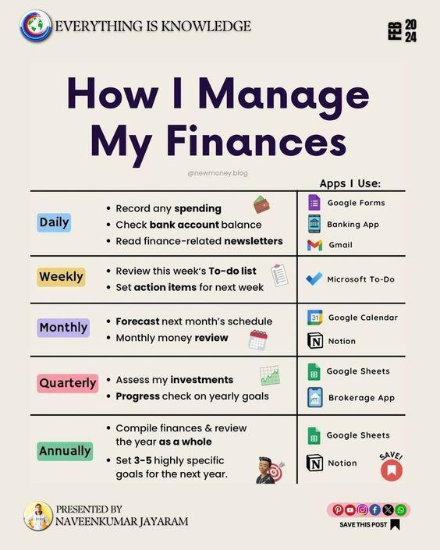

Slide 14
Wesley’s sermon on money
1. Gain all you can
2. Save all you can
3. Give all you can

Slide 15
GOD’S WAY OF MANAGING MONEY?

Slide 16
Money Management in the Bible – Trust in the Lord in managing resources
1 Timothy 6: 7 “Instruct those who are rich in the present age not to be arrogant or to set their hope on the uncertainty of wealth, but on God, who richly provides us with all ...”
Proverbs 3: 5 – 6 "Trust in the LORD with all your heart, and do not lean on your own understanding. In all your ways acknowledge him, and he will make straight your paths.”
Philippians 4: 6 “Do not be anxious about anything, but in everything by prayer and supplication with thanksgiving let your requests be made known to God.”

Slide 17
Money Management in the Bible - Budgeting
Luke 14: 28 “But don’t begin until you count the cost. For who would begin construction of a building without first calculating the cost to see if there is enough money to finish it? Otherwise, you might complete only the foundation before running out of money, and then everyone would laugh at you. They would say, ‘There’s the person who started that building and couldn’t afford to finish it!”
Proverbs 24: 27 "Prepare your work outside; get everything ready for yourself in the field, and after that build your house.”

Slide 18

Money Management in the Bible – Reserve Funds
In Genesis 41:34-36, we read, "Let Pharaoh proceed to appoint overseers over the land and take one-fifth of the produce of the land of Egypt during the seven plentiful years. And let them gather all the food of these good years that are coming and store up grain under the authority of Pharaoh for food in the cities, and let them keep it. That food shall be a reserve for the land against the seven years of famine that are to occur in the land of Egypt, so that the land may not perish through the famine.”
Proverbs 6:6-8 says, "Go to the ant, you sluggard; consider its ways and be wise! It has no commander, no overseer or ruler, yet it stores its provisions in summer and gathers its food at harvest"

Slide 19
Money Management in the Bible – Stay away from bad debt
Romans 13:8
Let no debt remain outstanding except the continuing debt to love on another.
Proverbs 22: 7
“The rich rules over the poor, And the borrower is the slave of the lender.”

Slide 20
Money Management in the Bible – Generational wealth
Proverbs 13:11 ESV
Wealth gained hastily will dwindle, but whoever gathers little by little will increase it.
Proverbs 13:22 ESV
A good man leaves an inheritance to his children's children, but the sinner's wealth is laid up for the righteous.
1 Timothy 5:8 ESV
But if anyone does not provide for his relatives, and especially for members of his household, he has denied the faith and is worse than an unbeliever.

Slide 21

Money Management in the Bible – Risk Management
Ecclesiastes 11: 2
"Give a portion to seven, or even to eight, for you know not what disaster may happen on earth.”

Slide 22


Discussion and sharing

Slide 23

Contact information:
Rannoi Sedumo, Member of South African Institute of Professional Accountants
MCSA General Treasurer
Email address: rannoi@mco.org.za
MCO office number: 011 615 1616

